Slide 1



Ad_Hoc Insights
Consumer Goods
Atliq Hardware
SQL PROJECT

Slide 2

About the Company
Atliq Hardware, a prominent computer hardware manufacturer in India, has established a notable presence in International Markets.

Slide 3

Mission
To Enhance Atliq Hardware's decision-making capabilities by strengthening the data analytics team. This involves addressing the lack of actionable insights through recruiting and ultimately enabling the company to meet business demands, including handling 10 Ad Hoc data requests.
Our Mission and Vision
Vision
To build a robust data-driven decision-making framework at Atliq Hardware by fostering a skilled data analytics team proficient in SQL. This will empower the company to efficiently analyze data, gain actionable insights, and drive strategic growth and operational excellence.

Slide 4

Atliq’s Product structure diagram
N & S
P & A
PC
Networking
Storage
Accessories
Peripherals
Desktop
Notebook
Wifi
Extender
External Solid
State Drive
Batteries
Graphic Card
Business
Laptop
Business
Laptop
USB Flash
Drive
Keyboard
Internal HDD
Personal
Laptop
Gaming
Laptop
Mouse
MotherBoard
Personal
Laptop
Processors

Slide 5

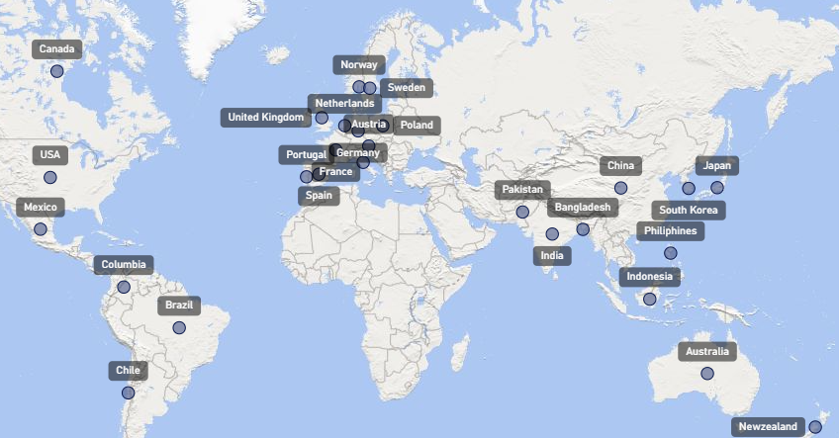
Atliq’s Global Market Presence

Slide 6

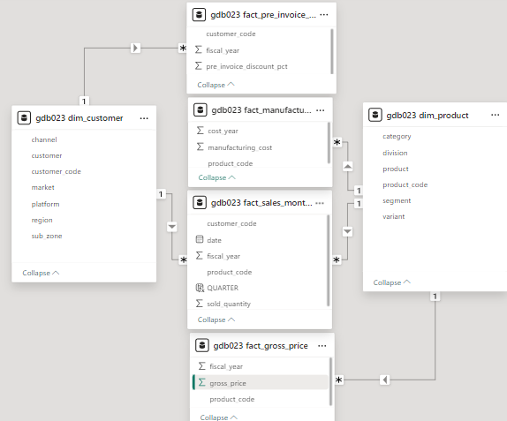
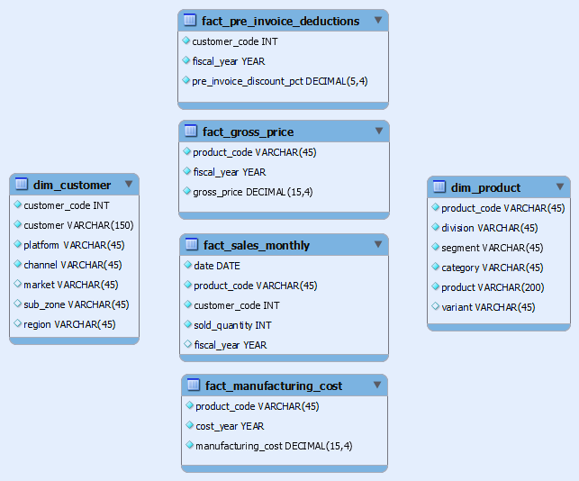



Data and Visualization Tool
Star Schema
EER DIAGRAM

Slide 7

Ad_hoc Requests
Provide the list of markets in which customer "Atliq Exclusive" operates its business in the APAC region.
What is the percentage of unique product increase in 2021 vs. 2020? The final output contains these fields unique_products_2020 , unique_products_2021 percentage_chg
Provide a report with all the unique product counts for each segment and sort them in descending order of product counts.The final output contains 2 fields segment, product_count
Follow-up: Which segment had the most increase in unique products in 2021 vs 2020? The final output contains these fields segment, product_count_2020 ,product_count_2021 , difference
Get the products that have the highest and lowest manufacturing costs. The final output should contain these fields product_code, product manufacturing_cost
Generate a report which contains the top 5 customers who received an average high pre_invoice_discount_pct for the fiscal year 2021 and in the Indian market. The final output contains these fields customer_code customer average_discount_percentage
Get the complete report of the Gross sales amount for the customer “Atliq Exclusive” for each month. This analysis helps to get an idea of low and high-performing months and take strategic decisions. The final report contains these columns Month Year Gross sales Amount
In which quarter of 2020, got the maximum total_sold_quantity? The final output contains these fields sorted by the total_sold_quantity, Quarter total_sold_quantity
Which channel helped to bring more gross sales in the fiscal year 2021 and the percentage of contribution? The final output contains these fields channel gross_sales_mln percentage
Get the Top 3 products in each division that have a high total_sold_quantity in the fiscal_year 2021? The final output contains these fields division, product_code

Slide 8


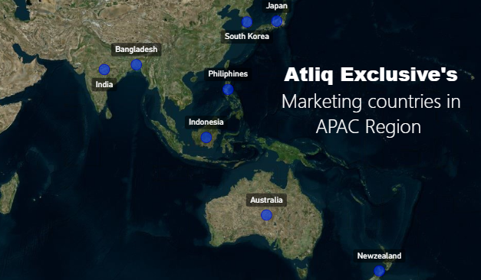
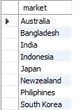


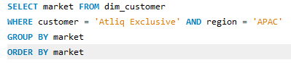
Request 1 - Provide the list of markets in which customer "Atliq Exclusive" operates its business in the APAC region
SQL QUERY

Slide 9

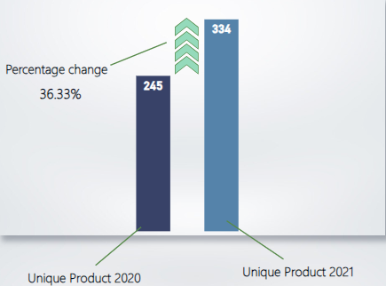
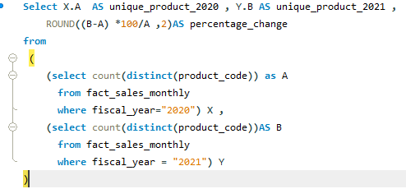
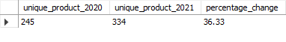
Request 2 - What is the percentage of unique product increase in 2021 vs. 2020? The final output contains these fields,
unique_products_2020
unique_products_2021
percentage_chg
SQL QUERY

Slide 10

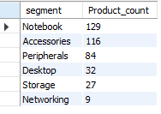
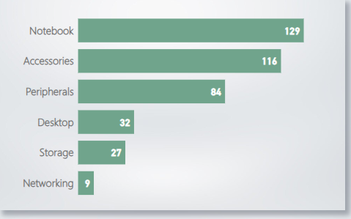
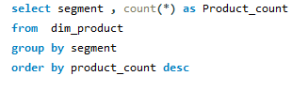
Request 3 - Provide a report with all the unique product counts for each segment and sort them in descending order of product counts. The final segment
product_count
SQL QUERY
After Analyzing the chart, we identified a Total of 6 distinct product categories: Notebooks, Accessories, Peripherals, Desktops, Storage, and Networking. Among these, Notebooks lead with the highest production volume at 129 units, while Networking has the lowest production count at just 9 units.

Slide 11

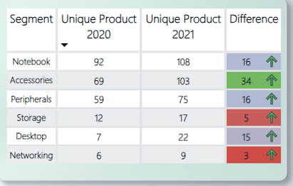
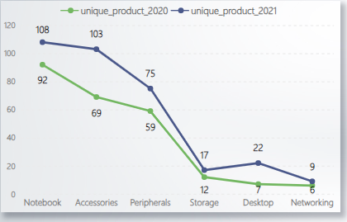
Request 4 - Follow-up: Which segment had the most increase in unique products in 2021 vs 2020? The final output contains these fields,
segment
product_count_2020
product_count_2021
difference
Storage(5) and networking(3) are seeing slower production growth compared to other categories.
Variation in distinct products across segments between 2020 and 2021
Accessories experienced the highest growth in production By 34

Slide 12
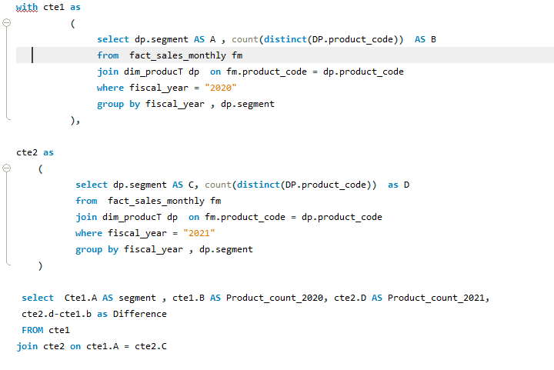
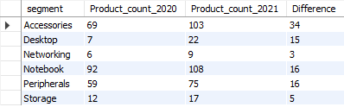
SQL QUERY

Slide 13



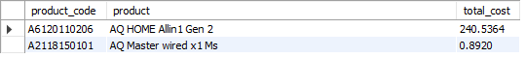
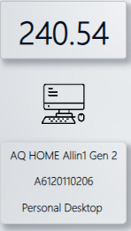
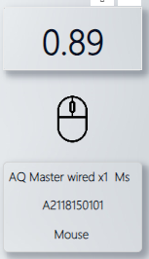
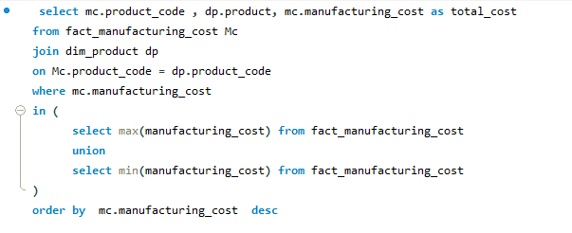
Request 5 - Get the products that have the highest and lowest manufacturing costs. The final output should contain these fields,
product_code
product
manufacturing_cost
Product Having the
HIGHEST & LOWEST
manufacturing cost
The AQ Master Wired X1 Ms (Standard1 variant) has the Lowest production expense.
Personal Desktop: AQ Home Allin1 Gen2 (Variant:Plus3) has the Highest production expense.
SQL QUERY

Slide 14

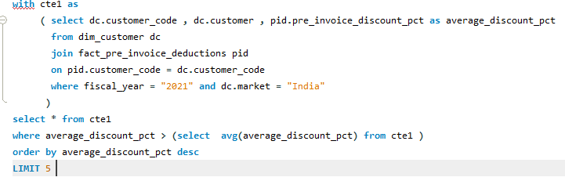
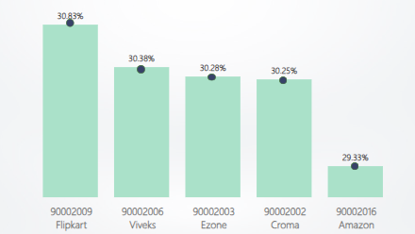
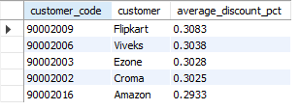
Request 6 - Generate a report which contains the top 5 customers who received an average high pre_invoice_discount_pct for the fiscal year 2021 and in the Indian market. The final output contains these fields,
customer_code
customer
average_discount_percentage
Top 5 Indian Customer with highest average discount Percentage by FY 2021
SQL QUERY
Flipkart received the highest average pre-invoice discount.
Amazon received the lowest average pre-invoice discount.

Slide 15

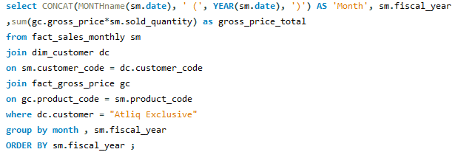
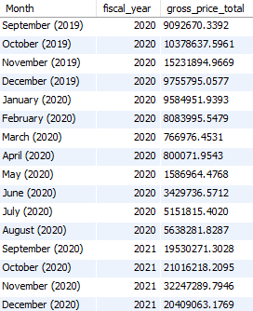

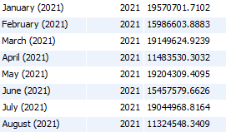
Request 7 - Get the complete report of the Gross sales amount for the customer “Atliq Exclusive” for each month. This analysis helps to understand low and high-performing months and take strategic decisions. The final report contains these columns:
Month
Year
Gross sales Amount
FY 2020
79.5 M
SQL QUERY
March 2020 (0.77M) recorded the Lowest Gross Sales total across both fiscal years.
November 2021(32.25M) recorded the Highest Gross Sales total across both fiscal years.
FY 2021
224.4M

Slide 16

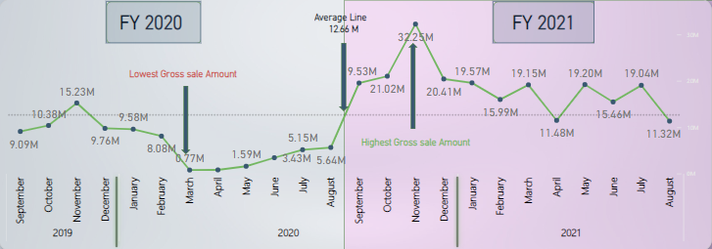
Monthly Report on Gross Sales Amount Atliq Exclusive

Slide 17

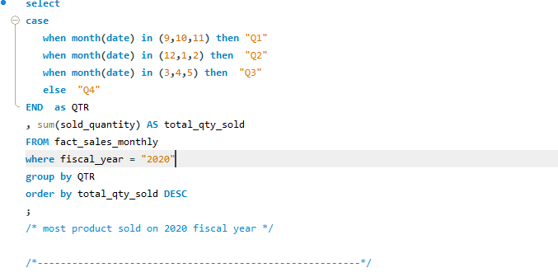
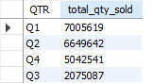
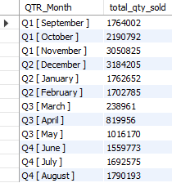
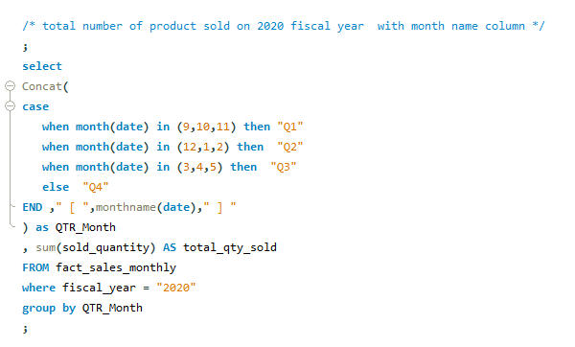
Request 8 - In which quarter of 2020, got the maximum total_sold_quantity? The final output contains these fields sorted by the total_sold_quantity,
Quarter
total_sold_quantity
Fiscal year 2020 saw the Highest Product Sales in Quarter 1 (7.01 M) and the Lowest in Quarter 3 (2.08M)
November 2021(32.25M) recorded the Highest Gross Sales total across both fiscal years.
SQL QUERY

Slide 18

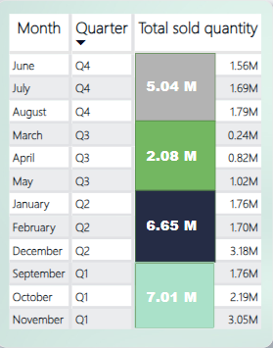
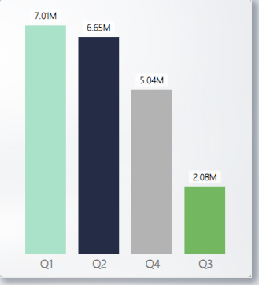
Total Sold Quantity in FY 2020 By Quarter

Slide 19

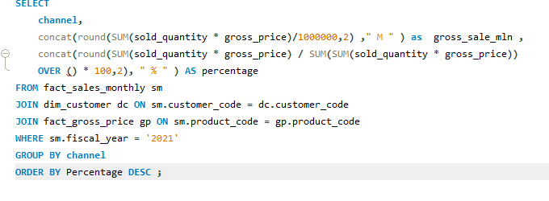
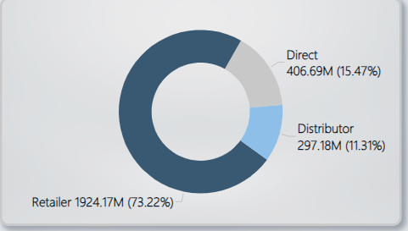
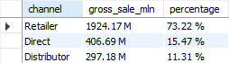
Request 9 - Which channel helped to bring more gross sales in the fiscal year 2021 and the percentage of contribution? The final output contains these fields,
channel
gross_sales_mln
percentage
Total sales and contribution percentages across channels for FY 2021
SQL QUERY
The majority of sales, 73.22%, were made through Retailers, while only 11.31% came from the Distributor Channel.

Slide 20

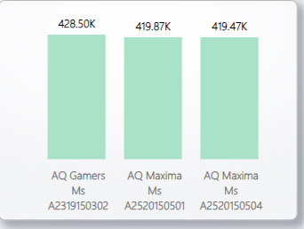
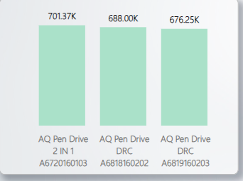
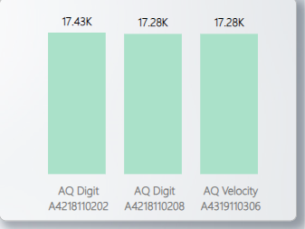



Request 10- Get the Top 3 products in each division that have a high total_sold_quantity in the fiscal_year 2021? The final output contains these fields, division
product_code
Top 3 Best - Selling product in each Division for FY 2021
P & A
N & S
PC
Standard 2
Standard 1
Plus 2
Premium
Plus
Premium
Standard
Blue
Premium
Misty Green
Plus Red

Slide 21

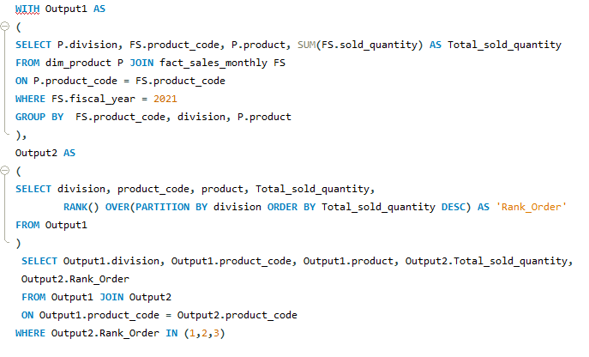
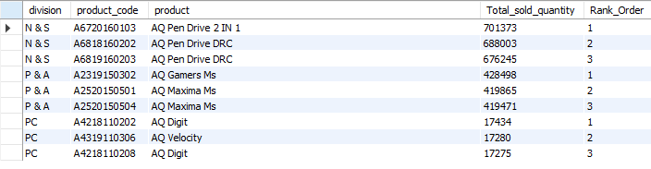
SQL QUERY

